Slide 1
Application Engineering and Dev-Sec 04-Fall 2018
Final Project presentation
Online Voting System
-Dimple Zatkia (001474071)
-Reema Mehta (001495588)
-Aesha Shah (001495716)

Slide 2
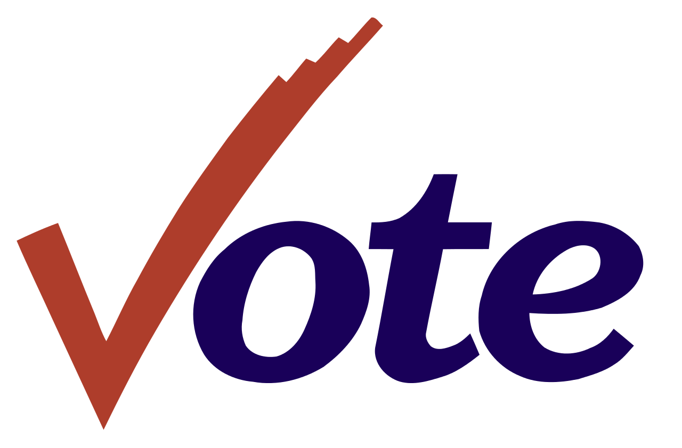
Problem Statement
Online voting system is a system that facilitates the running of the elections as well as surveys online. System will provide online registration forms to the users before voting and makes the users to cast their vote online. System should be developed with high security and user friendly environment.
System should be developed for use by everyone with a simple and self explanatory GUI. The main objective of this study is an important step towards streamlining this effort is to develop a framework and identify necessary properties that a secure and trusted online voting system must satisfy to reduce discovery redundancy.

Slide 3

Approach
Implementing the entire concept of online voting system in the ecosystem provided, we started off making a prototype using a simple GUI involving various regions/states as network of the ecosystem.
Enterprises being different parties involved in the voting criteria, users will be involved in two different ways and communicated as voter organization and candidate organization.
There will be one system admin handling all the networks, enterprises and organization while there is another admin organization which will handle voters and candidates respectively.
Users will be asked to provide details while registering and their identities will be authenticated and verified by the admin resulting in receiving an email with their initial credentials.
Using their initial credentials voters will be able to cast their vote and candidates will be able to view their respective profiles.

Slide 4
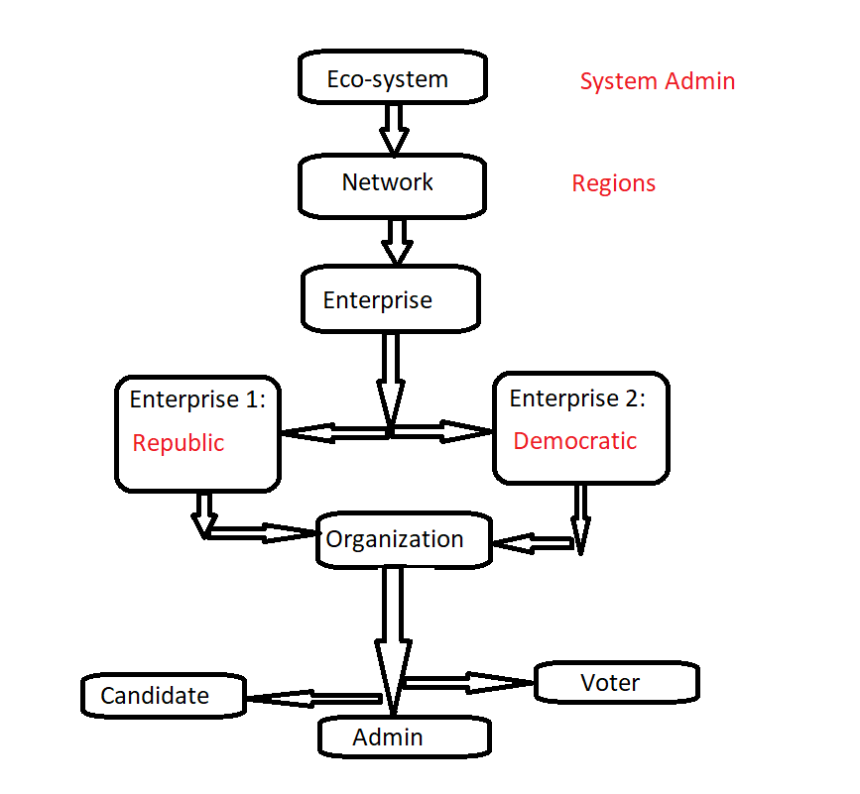
O
B
J
E
C
T
M
O
D
E
L

Slide 5

Use cases
Login case: On providing valid credentials; system admin, admin and respective users should be able to login and start working on their respective pages.
Registration form: Users should be able to register themselves providing personal information.
System admin should be able to manage different networks(regions), enterprise and organizations under it.
At organization level, Admin will be managing candidate and voter information; along with the process of verification and providing initial credentials to the users via email.
StateID provided by the user should be stored and encrypted using block chain only after the request is approved by the admin.
Voter users should be able to cast vote to the respective selected candidate.

Slide 6
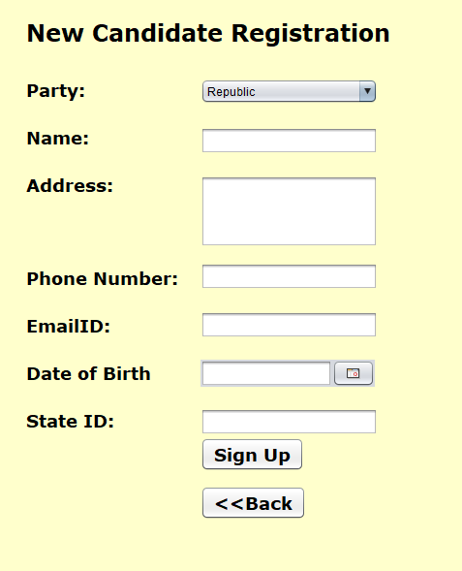
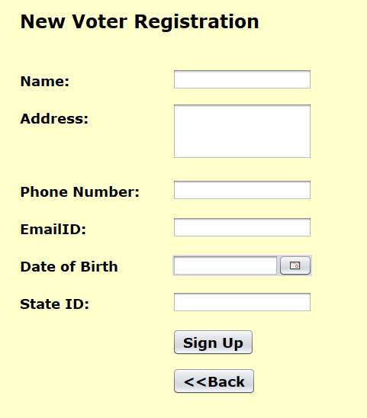
Registration Pages

Slide 7
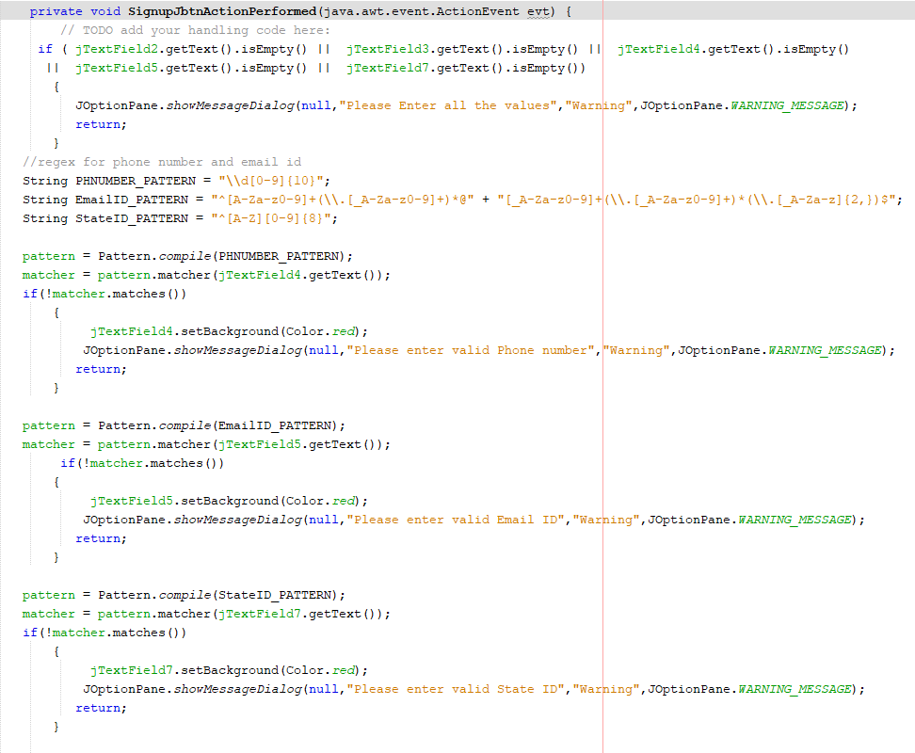

Slide 8
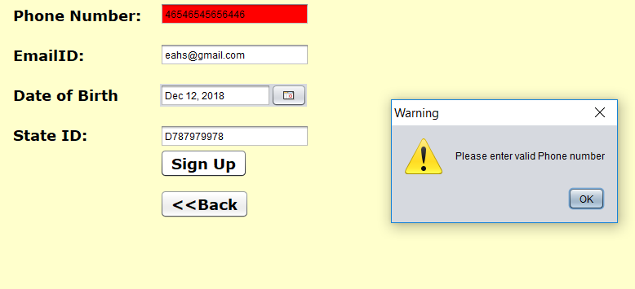
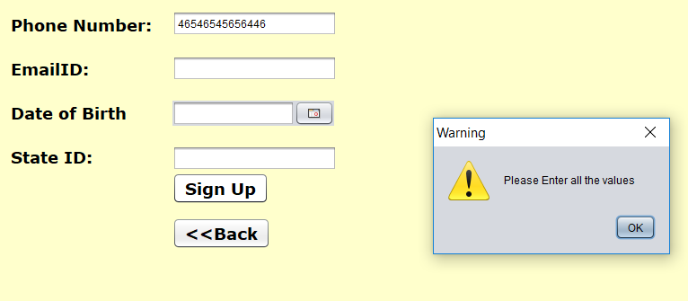
Screenshots
Registration pages have various validations and regex used as seen in the screenshots, Phone number has to be 10 digits, regex in email id and State id should have only 1 uppercase alphabet and it should be of 9 digits.
Same is done with candidate and voter registration pages.

Slide 9
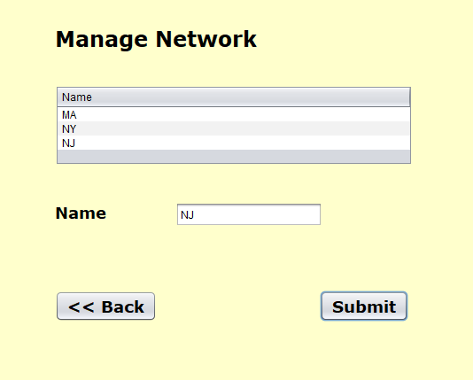
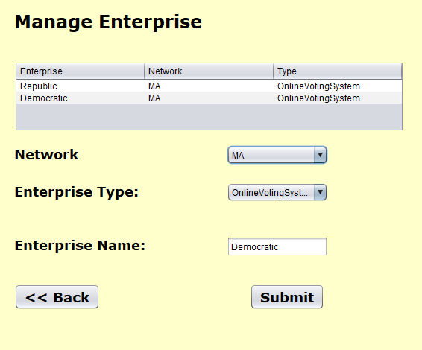
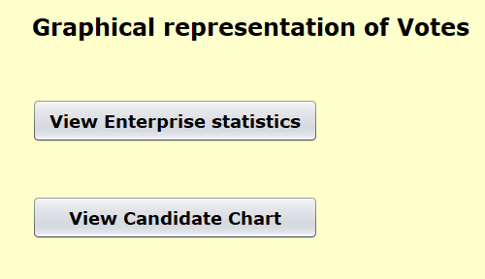
System admin will be managing networks, enterprise and will be able to view graphical representation.

Slide 10
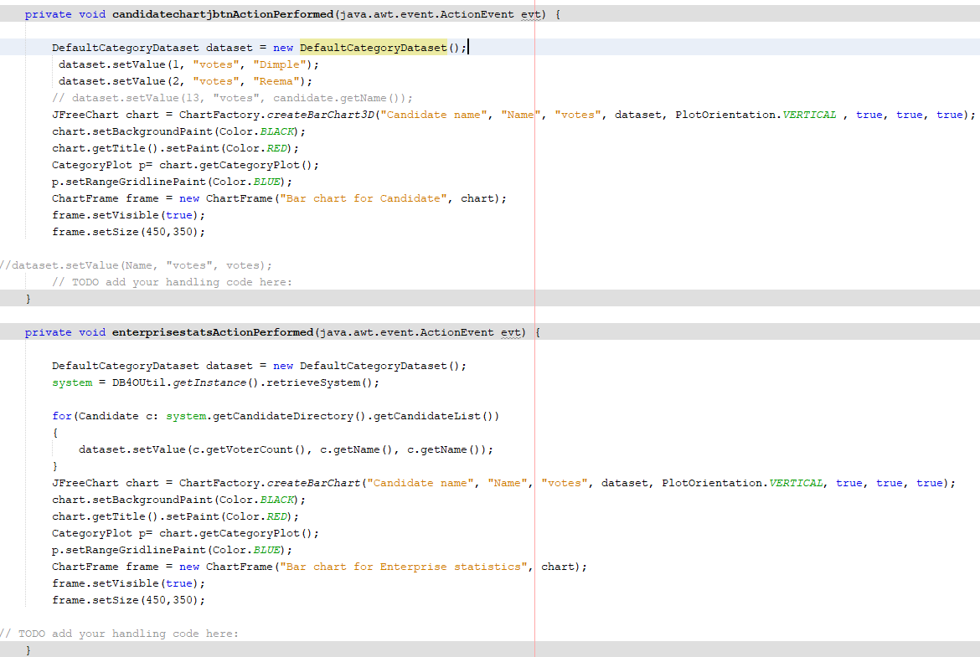

Slide 11
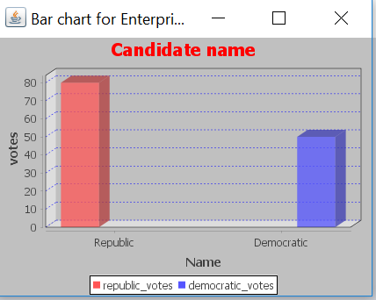
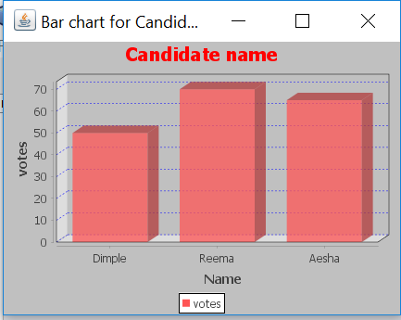
Screenshots
Graphs shown here are results of vote count and respective enterprises as well as the candidates.

Slide 12
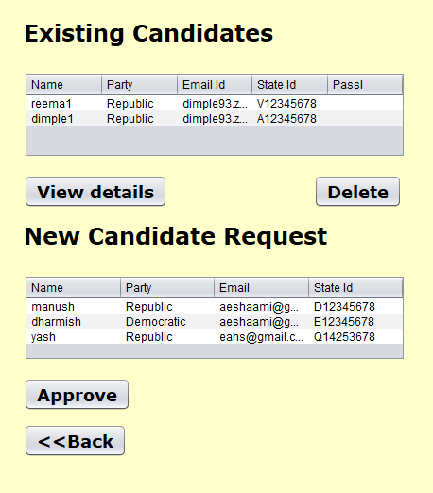
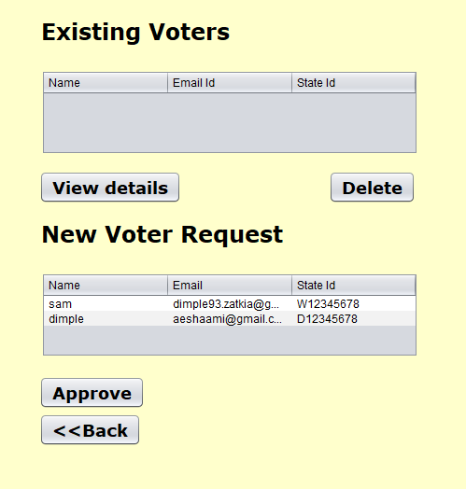
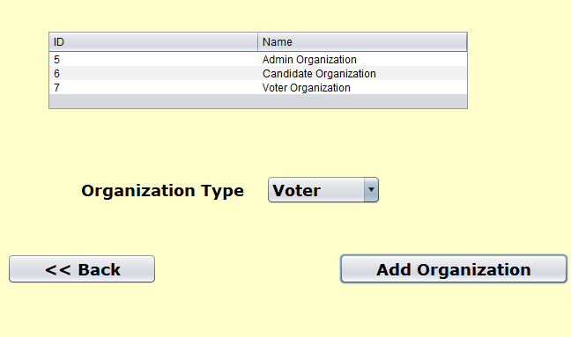
Admin will manage the voters and candidates approval by which users will receive an email containing their initial login credentials.

Slide 13
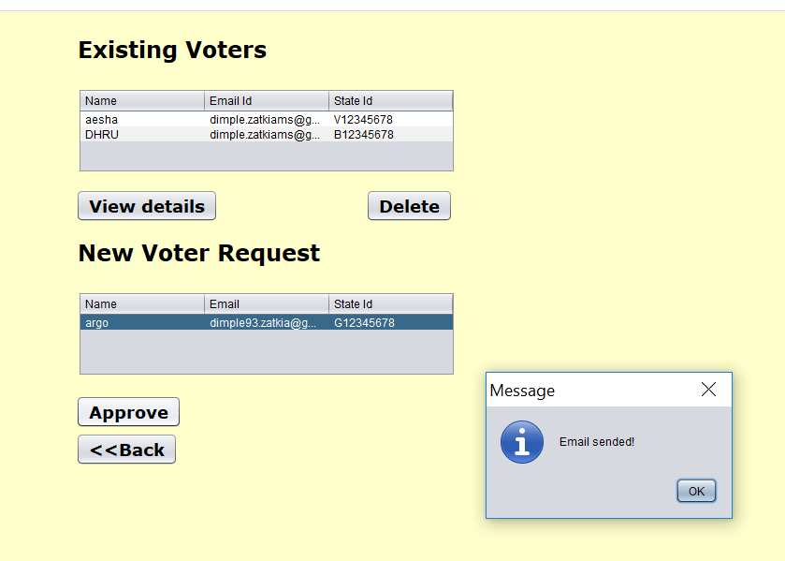

Slide 14
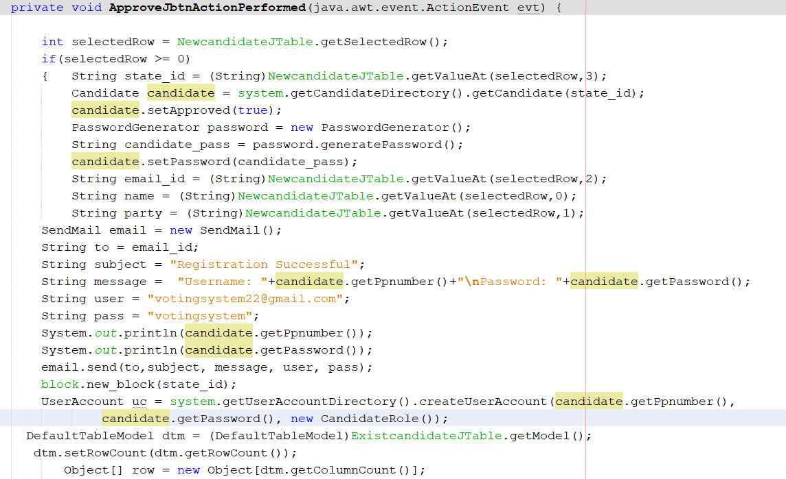
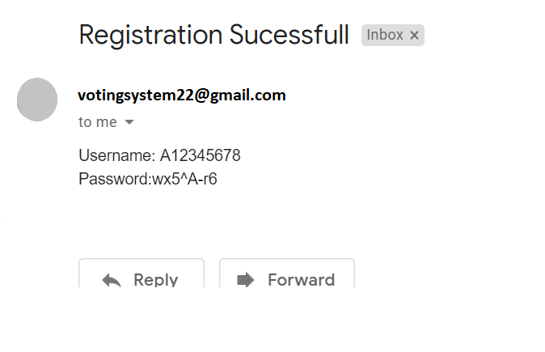
Email functionality and its working

Slide 15
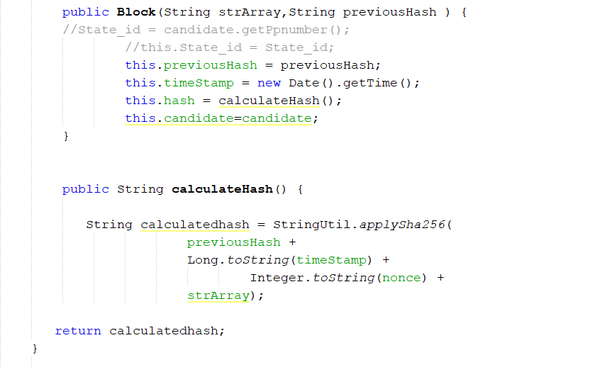
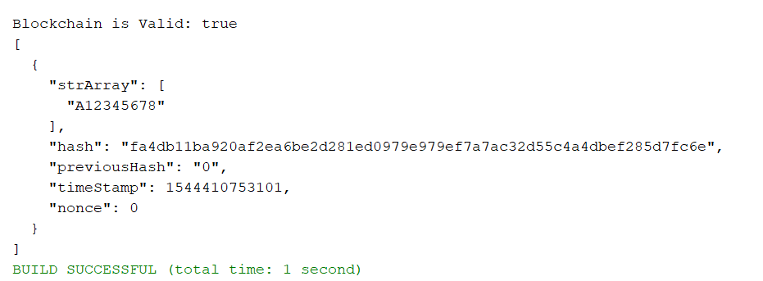
Screenshots
Block chain is encrypting State ID and storing it in a Algorithm

Slide 16
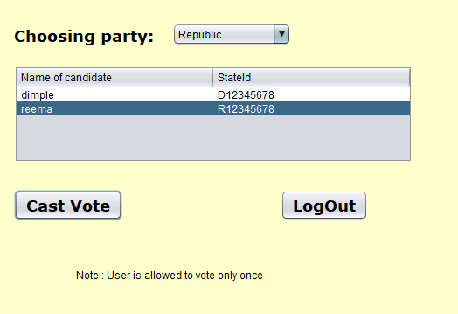
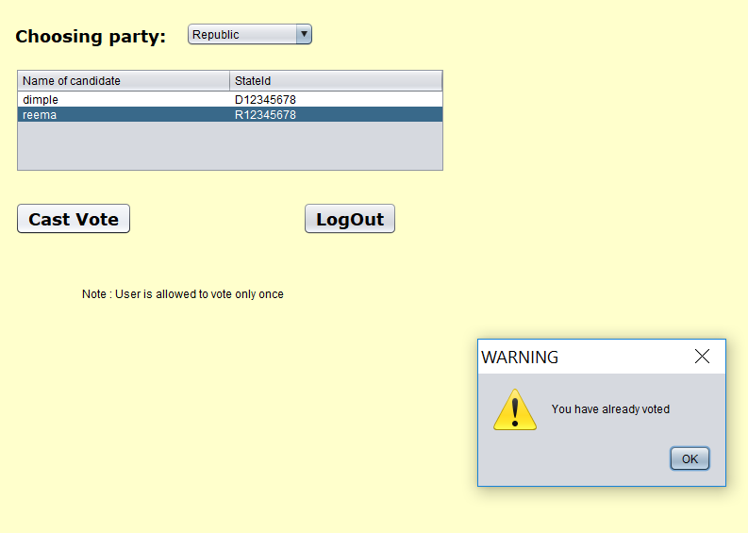
Voter Login and work area

Slide 17
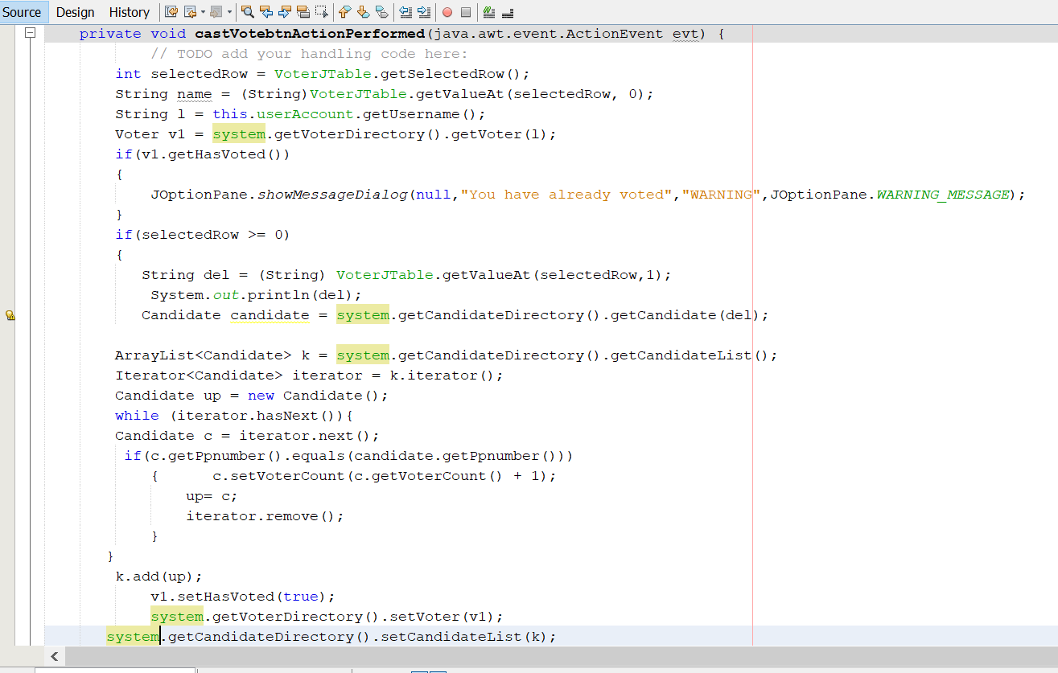

Slide 18
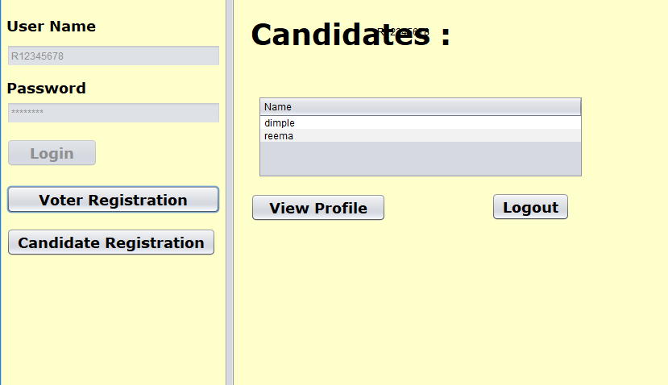
Candidate login and work area

Slide 19

Advantages
The Online Voting System shall reduce the time spends making long queues at the polling stations during voting.
It shall also enable the voters to vote from any part of the globe since this is an online application available on the internet. Case of miscount.
Cases of miscount shall also be solved. It is to make sure that the people vote is counted, for fairness in the elective positions.
Less effort and less labor intensive, as the primary cost and focus primary on creating, managing and running a secure web voting portal.
Increasing number of voters as individuals will find it easier and more convenient to vote, especially those abroad.

Slide 20

Future scope
This application is just a prototype for the idea of e-voting and reducing manual electronic voting efforts in the system.
Future scope can have high level of authentication which can include user detail verification
There exist various methods to secure the Voting process. Our project used block chain to encrypt the data(state-id) and made it secure. In future more complex code can be used and made for hacking and related issues. It can be extended to more Security Using various level of Authentication and Verification. More Security and Privacy Issues can be maintained by using various aspects.
By online voting system percentage of voting increases and cost and time of voting process is decreased. It is easy to use and it is less time consuming.

Slide 21


